Slide 1
Immigration law in the united states
“Give me your tired, your poor, Your huddled masses”

Slide 2
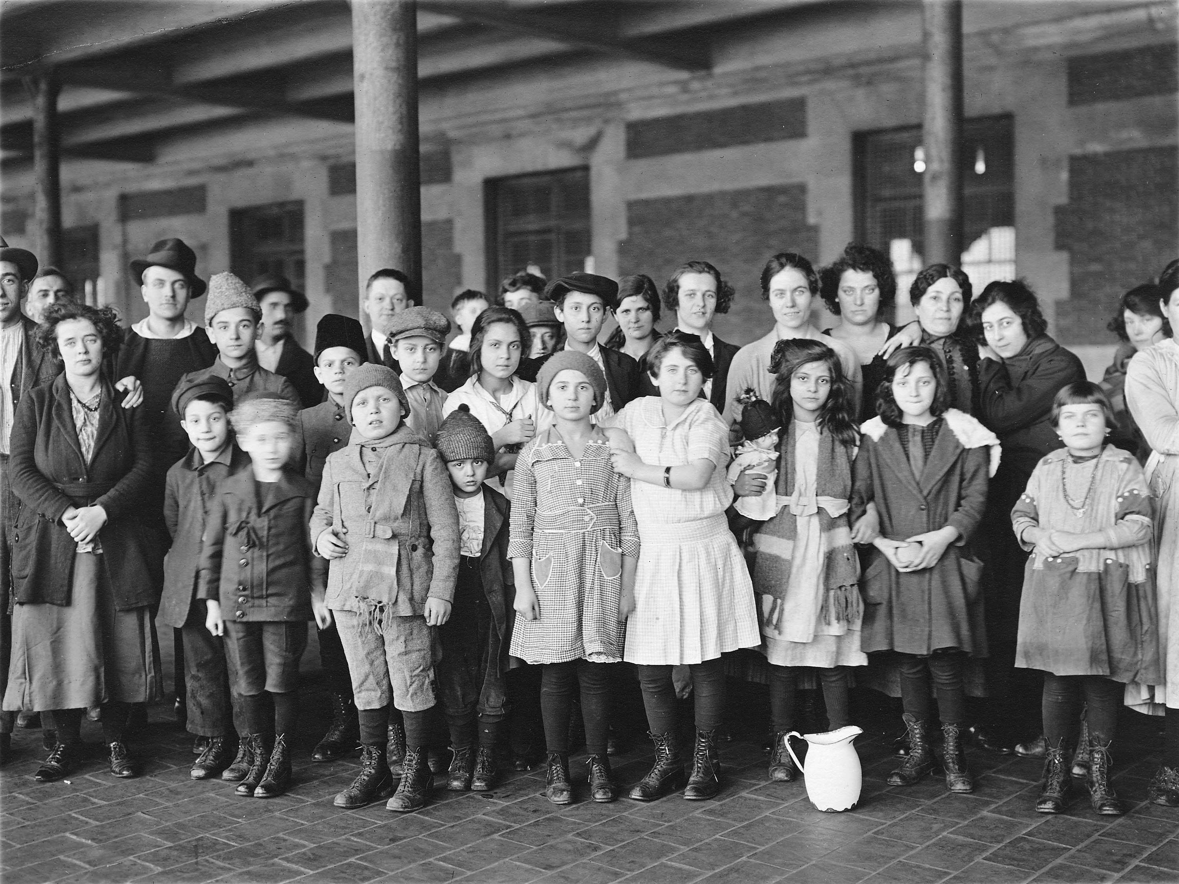
Who is an immigrant?
An __________ is someone who leaves one country to __________ ___________in another country.
Immigrants come to the United States for many different reasons.
Why do you think people immigrate to the United States?

Slide 3
Citizens vs. Non-Citizens
There are three classes of ____ ________ in the United States
_______ ______________ _____________
____________ _______________
Non-immigrants
Non-immigrants are __________ who enter the United States temporarily
We will not focus on this group of non-citizens

Slide 4
Lawful Permanent Resident
A ________ __________ __________ (LPR) is a person living in the United States with permission from the U.S government and with a “______ _________”.
Green card is the term many people use to refer to a lawful permanent resident card.
A LPR may live in the United States indefinitely and may become citizens through ______________.
Naturalization is how a person not born in this country but holds the status of full time resident becomes a citizen.

Slide 5
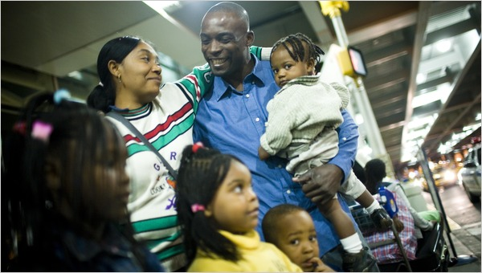
Lawful Permanent Resident & Refugee
__________ come to this country after leaving a country that was not safe for them to live in.
After ______ __________ in the United States a refugee can apply to change their immigration status from refugee to lawful permanent resident status and get a green card.

Slide 6
Undocumented Migrant
"Illegal" or "unauthorized" immigrants enter the US without official permission.
Undocumented migrants may pass through inspection with fraudulent documents, enter legally but overstay the terms of their temporary visas, or somehow violate other terms of their visa.

Slide 7
Deportation
Deportation, now called removal, is the process of removing a person from the United States.
Generally, when a person is deported they are no longer allowed to live, work or visit the United States.

Slide 8
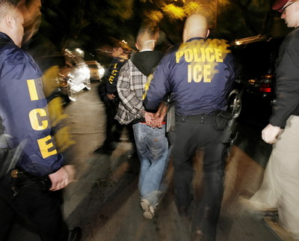
Who can be deported?
Any person that is living in the United States that is not a _______ can be _________ if they break the law.
This includes immigrants with ________ __________ to be in the country.
It also includes political refugees that have been in this country since they were ____________.

Slide 9
No Second Chance
Current immigration laws utilize a “____ ___________ __________” framework.
Non-citizens living in the United States that have committed certain crimes, even if it was just one crime, are at risk of being deported.
It only takes ______ crime or ______ wrong decision to be deported.

Slide 10
Why does someone get deported?
A non-citizen can be deported for a number of reasons;
Having entered the U.S without legal ____________.
Overstaying an ________ ________ or work permit
Having committed certain ___________ (whether in the country legally or not)

Slide 11
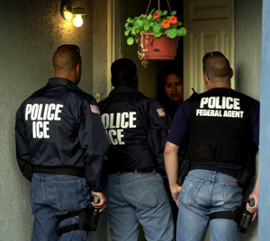
Which crimes lead to deportation?
According to federal immigration law, an ____________ ________ has the power to decide which crimes carry the penalty of deportation.
Which crimes do you think should lead to deportation?

Slide 12
Examples of crimes meriting deportation
 | Domestic violence against a spouse or boyfriend/girlfriend
Violent crimes
Renting a car and not retuning it as scheduled (auto theft) | Using false papers to get a job (fraud)
Writing bad checks
Fistfights, especially with a weapon | Kidnapping your girlfriend to marry her
 | Committing a crime as part of a gang
Threatening to harm or kill someone

Slide 13
What should a non-citizen do if they get in trouble with the law?
Talk to an _____________ immediately!
Pleading guilty to certain crimes will make you deportable and may eliminate any type of remedy from deportation.
Be ___________with your attorney about your citizenship status.
Do not apply for your own citizenship until you have talked to an immigration attorney because you may risk placing yourself in deportation (removal) proceedings.
Do not leave the U.S until you talk to an immigration attorney. If you are not a citizen, and you have a criminal record, you may not be allowed to return to the country.

Slide 14
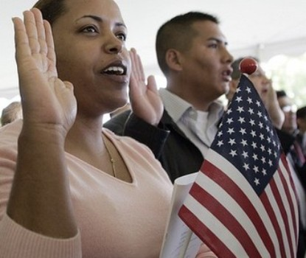
Tips for non-citizens
OBEY ALL LAWS!
Become a U.S citizen if you are eligible.
If you are under 18, help your parents become citizens as soon as possible. If you are a permanent resident and your parent becomes a U.S. citizen before you turn 18, then you will automatically become a citizen.

Slide 15
Final Word
Remember: any non-citizen can be deported if convicted of certain crimes. A person can be deported even if they have lived in this country since they were a small child, even if they only speak English, even if all of their family and friends are in this country, and even if they are under 18 (in some cases).
http://www.dailymotion.com/video/x2ta0n_sentenced-home-trailer_politics

